Slide 1
Predictive Performance Enhancement
Intervention Strategy

Slide 2
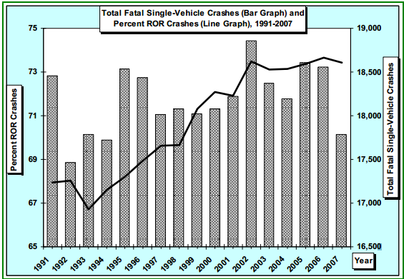
According to a Department of Transportation study, over 17,000 Single-Vehicle Crashes every year result in death.
Notes:
Study is Liu, C. and Submaranian, R. (2009) “Factors Related to Fatal Single-Vehicle Run-Off-Road Crashes”, DOT HS 811 232.
In ¾ of these years, there were over 18,000 single-vehicle crashes
“These are the accidents our system is helping to prevent”

Slide 3
Our System
Predictive Performance Enhancement
Collect data on dangerous roads
Determine user’s performance margin
Use data to determine if the user is likely to crash
Silently modify user’s input (acceleration, brakes, tire angle) to avoid accident
Notes:
Collect data from crash reports
Define Performance Margin, why it’s important
Use data including performance margin, GPS location, speed, acceleration, and other factors.

Slide 4
Our System
Simulation
Developing a realistic driving simulation to showcase the intervention software.
Designing a track based on real conditions that are likely to influence single-car accidents.
Notes:
Realistic involves realtime simulation, actually have someone controlling the car
Track conditions that may cause people to lose control of their car such as variable-radius turns and sharp, unseen turns.

Slide 5
Next Steps
Create a realistic user interface for our simulation
Create the simulated track that we will be driving on
Constantly improve vehicle model to be more realistic
Implement our Intervention Strategy to show that it will improve user performance

